Slide 1
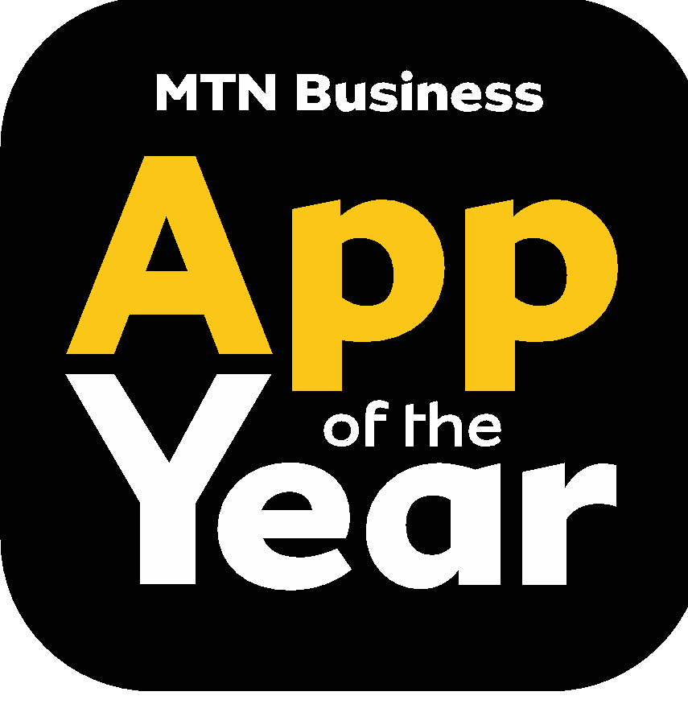
Business Model Canvas for team: Jurich Minnie
App Name: ZAPlanner
Replace red text with your own and make it black
More Concept X
Let’s look at XY
Key
Partners
Key
Activities
Value
Proposition
Customer
Relationships
Customer
Segments
Gives information on Load shedding, Traffic, Water Shortages, covid.
Allows users to plan their day.
Inform users on what is new in the app.
Notifications inform users about urgent alerts.
Opportunity for user feedback.
Eskom (Load shedding Schedule)
Municipalities (Water shortages , roadworks, traffic and covid numbers.)
Google Maps (Traffic)
Local radio stations or webpages.
Offer 3 Months of free premium to first-time users.
Provides a link that can be shared by customer. If 3 people download using the user’s link, the user will receive a premium account for 30 days.
Frequent updates makes the app more reliable.
Students who rely on power for studies and online classes.
People who don’t have time to do research on power, water, covid and traffic situations.
People who make use of transport rely on accurate traffic info.
XY can actually be used for 1-2-3 and is powerful with this and that
Key
Resources
Channels
Social media to interact with users
App available on website
App Store
Internet connection or data
Advertising
Servers and equipment like PCs.
Cost Structure
Revenue Streams
Internet Costs (Searching and gathering info to update)
Advertising Costs (Spread awareness of the app)
Server Costs
Equipment Costs (Computers and other hardware)
In-app Advertising for non-premium users.
Monthly service fee for premium users.

